Slide 1

The Key Principles and Practicalities of Earthworks
Paul Nowak, Technical Director – Infrastructure Geotechnics, Atkins
Peter Gilbert, Head of Ground Engineering & Tunnelling, Jacobs
21st June 2016
Western Regional Group – Geological Society

Slide 2
disclaimer
The views expressed in this presentation are those of the authors and are not necessarily those of our companies

Slide 3
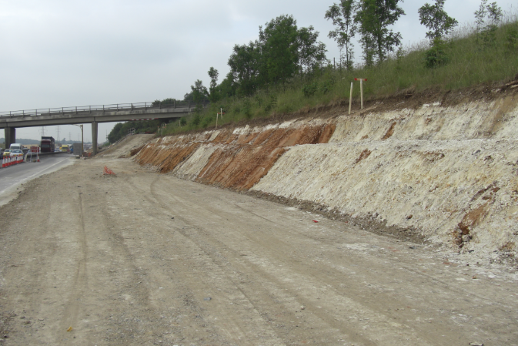
Earthworks - Introduction
Purpose
History
The Compaction Process
Earthworks Specifications
Fill Design & Setting Specification Limits
Analysis & Factors of Safety
Modes of Failure
Management of Existing Assets

Slide 4
Earthworks - Purpose

Slide 5
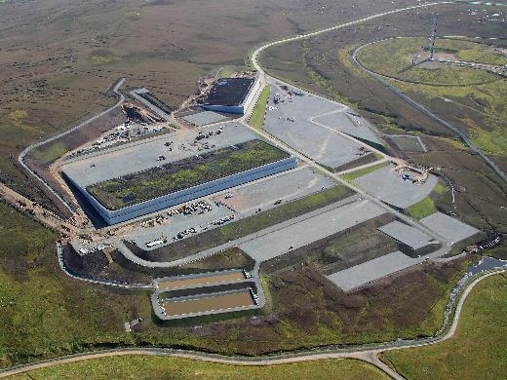
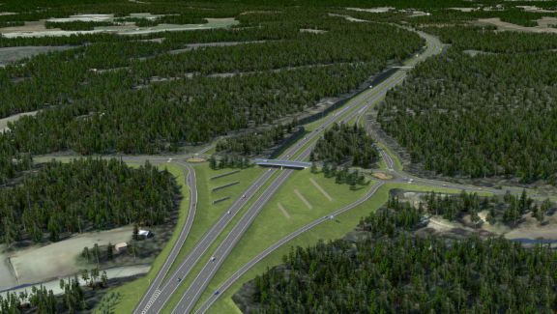
Earthworks - Purpose
The purpose of earthworks should be:
To produce a balance between excavated and placed materials
The provision of a well constructed excavation or formation of a reliable platform for the subsequent construction of engineering fill (Design)
The provision of a sound and durable fill, capable of being handled, placed and compacted to a standard which is appropriate to the requirements of the earthwork as a whole and any structures that it may support (Design & Specification)
Provision of a means of compaction to enable the serviceability (and if necessary the ultimate) limit state criteria to be met. (Specification)

Slide 6
Earthworks - History

Slide 7
Earthworks - History
  4000 years ago Stone Age Burial mounds
  Roman roads followed natural contours
  Canals, 18th century, construction generally horizontal with locks to overcome gradients
  Railways, 19th century, requirement for maximum 1V:50H gradient. (2 to 3 million cubic yards of material yearly between 1834-1841)
  Roads, from 1920's, generally gradient less than 1V:10H for major highways
  World War II saw the main developments in modern earthworks practice in the UK
  Major work on Earthworks on Transport Research Laboratory in 1950s to 1980s
  Major motorways predominantly constructed in 1970’s and 1980’s

Slide 8
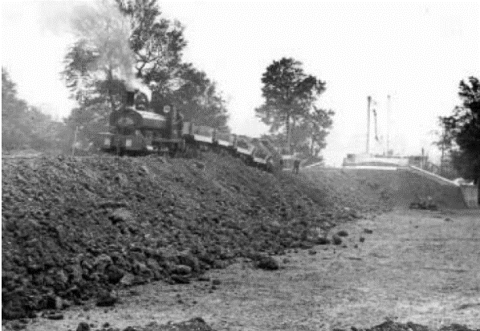
Earthworks - History
How were they constructed?
Initially bulk earthmoving by horse and wagon, then late 19th century steam driven plant
Material end or side tipped with no formal compaction but informal through traffic
Fill cut and placed at angle of natural repose
Generally no embankment foundation treatment.

Slide 9
Earthworks – Fill DESIGN & SETTING SPECIFICATION LIMITS

Slide 10
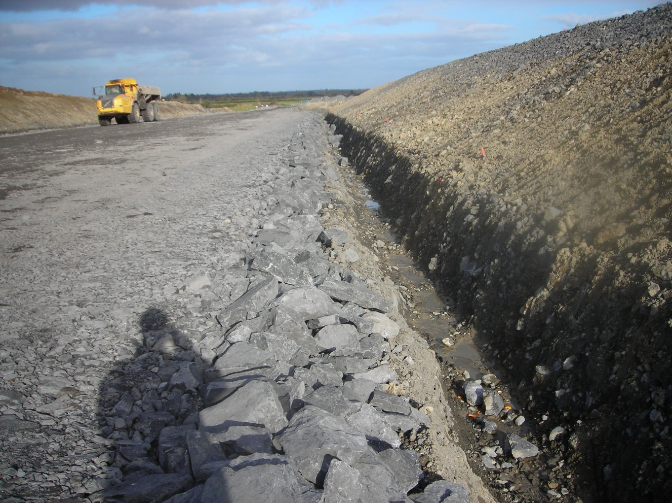
Earthworks Fill Design
the assessment & selection of fill material properties & compaction requirements
to enable construction & satisfy the required long-term properties of the earth structure
What determines success:
1/3rd Fill material available
1/3rd Design decisions
1/3rd Construction practice

Slide 11
Earthworks Fill Design
Questions to consider:
Geotechnical Design – what is required of the earthwork?
Fill Classification – what fills are available?
Compaction Process – what happens when fill is compacted?
Fill Design – what is necessary to satisfy the geotechnical design?
Construction Risks – what ground risks need to be managed on site?
Post-construction risks – how might fill properties change?
Specification preparation – how best to capture the fill design findings?
Construction QC – what on site checks will ensure the Spec is met?
low cost + problem free construction + acceptable performance = GOOD EARTHWORK

Slide 12
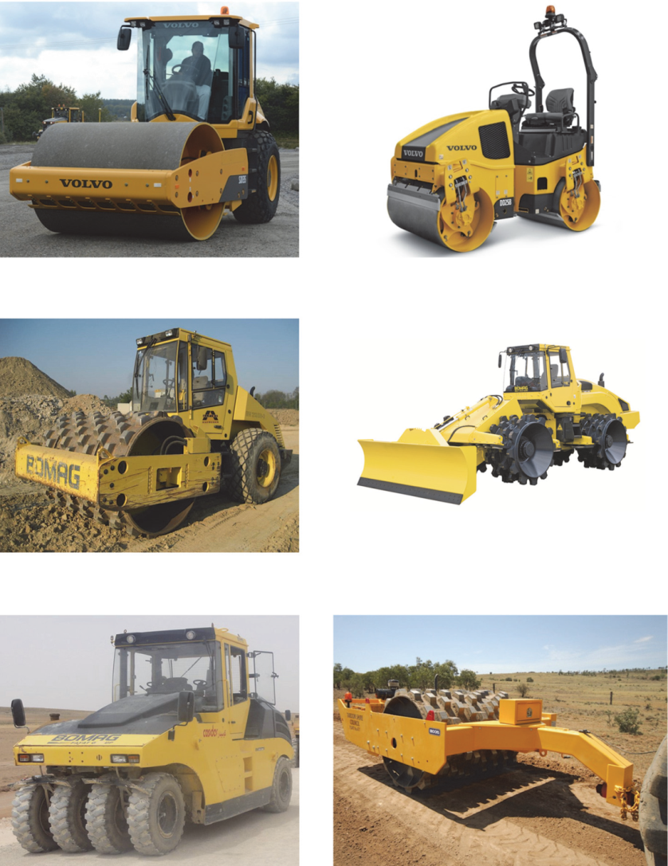
The Compaction Process
Compaction reduces the air voids
Avoid just creating pwp as that hinders compaction
air
water
soil

Slide 13
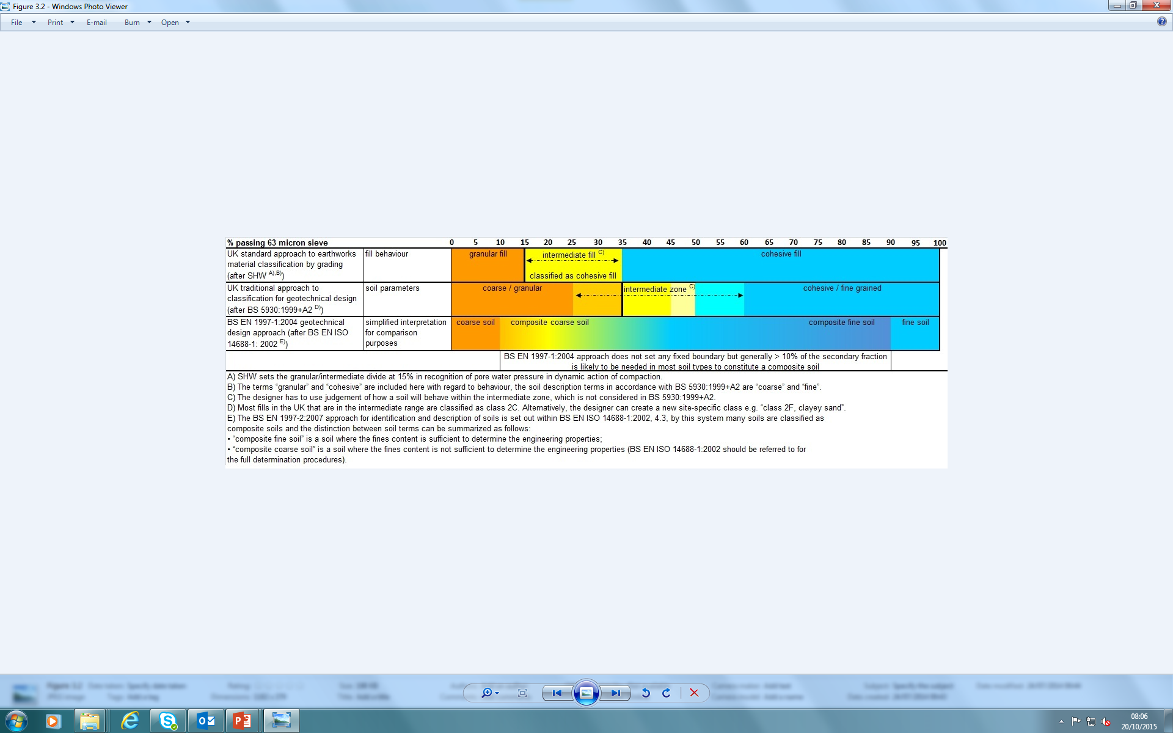
Fill Material Classification
UK earthworks practice - most of the classification process is part of the Specification for Highway Works (SHW) system
Determined by Transport Research Laboratory (TRL) extensive trials that established “method compaction”
Soils for geotechnical design (BS 5930) > 35% fines classified as fine soil
Fills for earthworks (BS 6031 and SHW) >15% fines classified as fine (“cohesive fill”), recognition of pore water pressure response to dynamic action of compaction plant
Composite soils / Intermediate fills

Slide 14
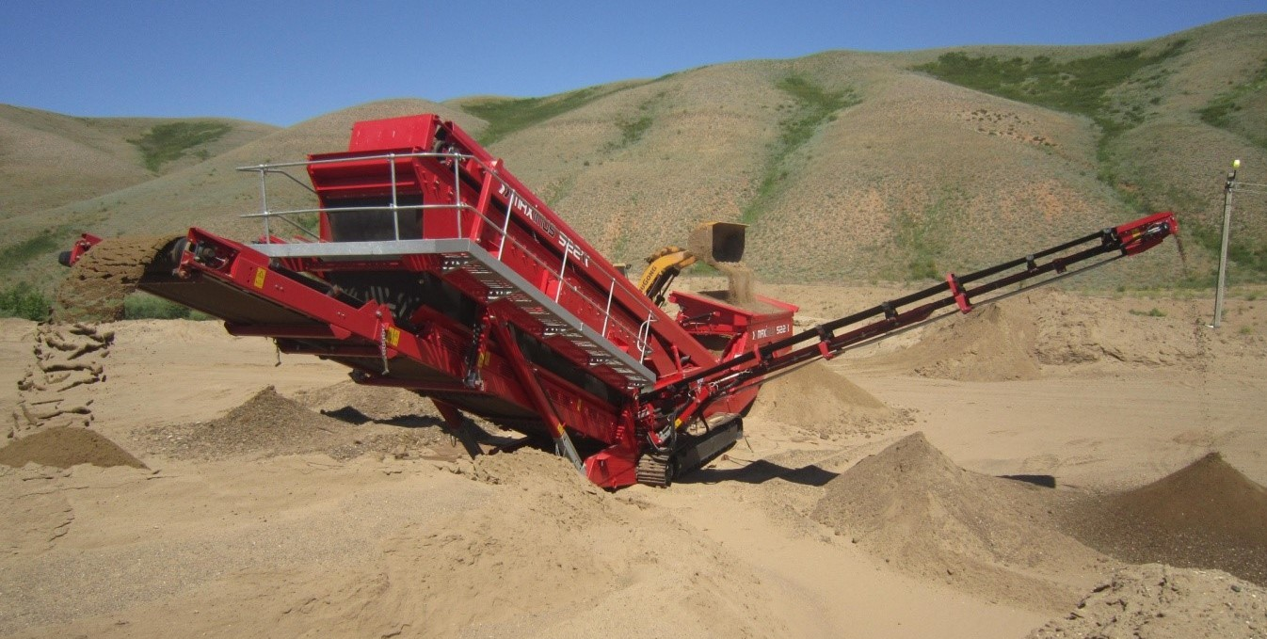
Fill Material Classification
Intrinsic properties - will not change without physical intervention, e.g.
  grading
  Atterberg limits
  organic content
  particle strength
State properties - can vary during earthwork process, e.g.
  water content
  soil strength
  density

Slide 15
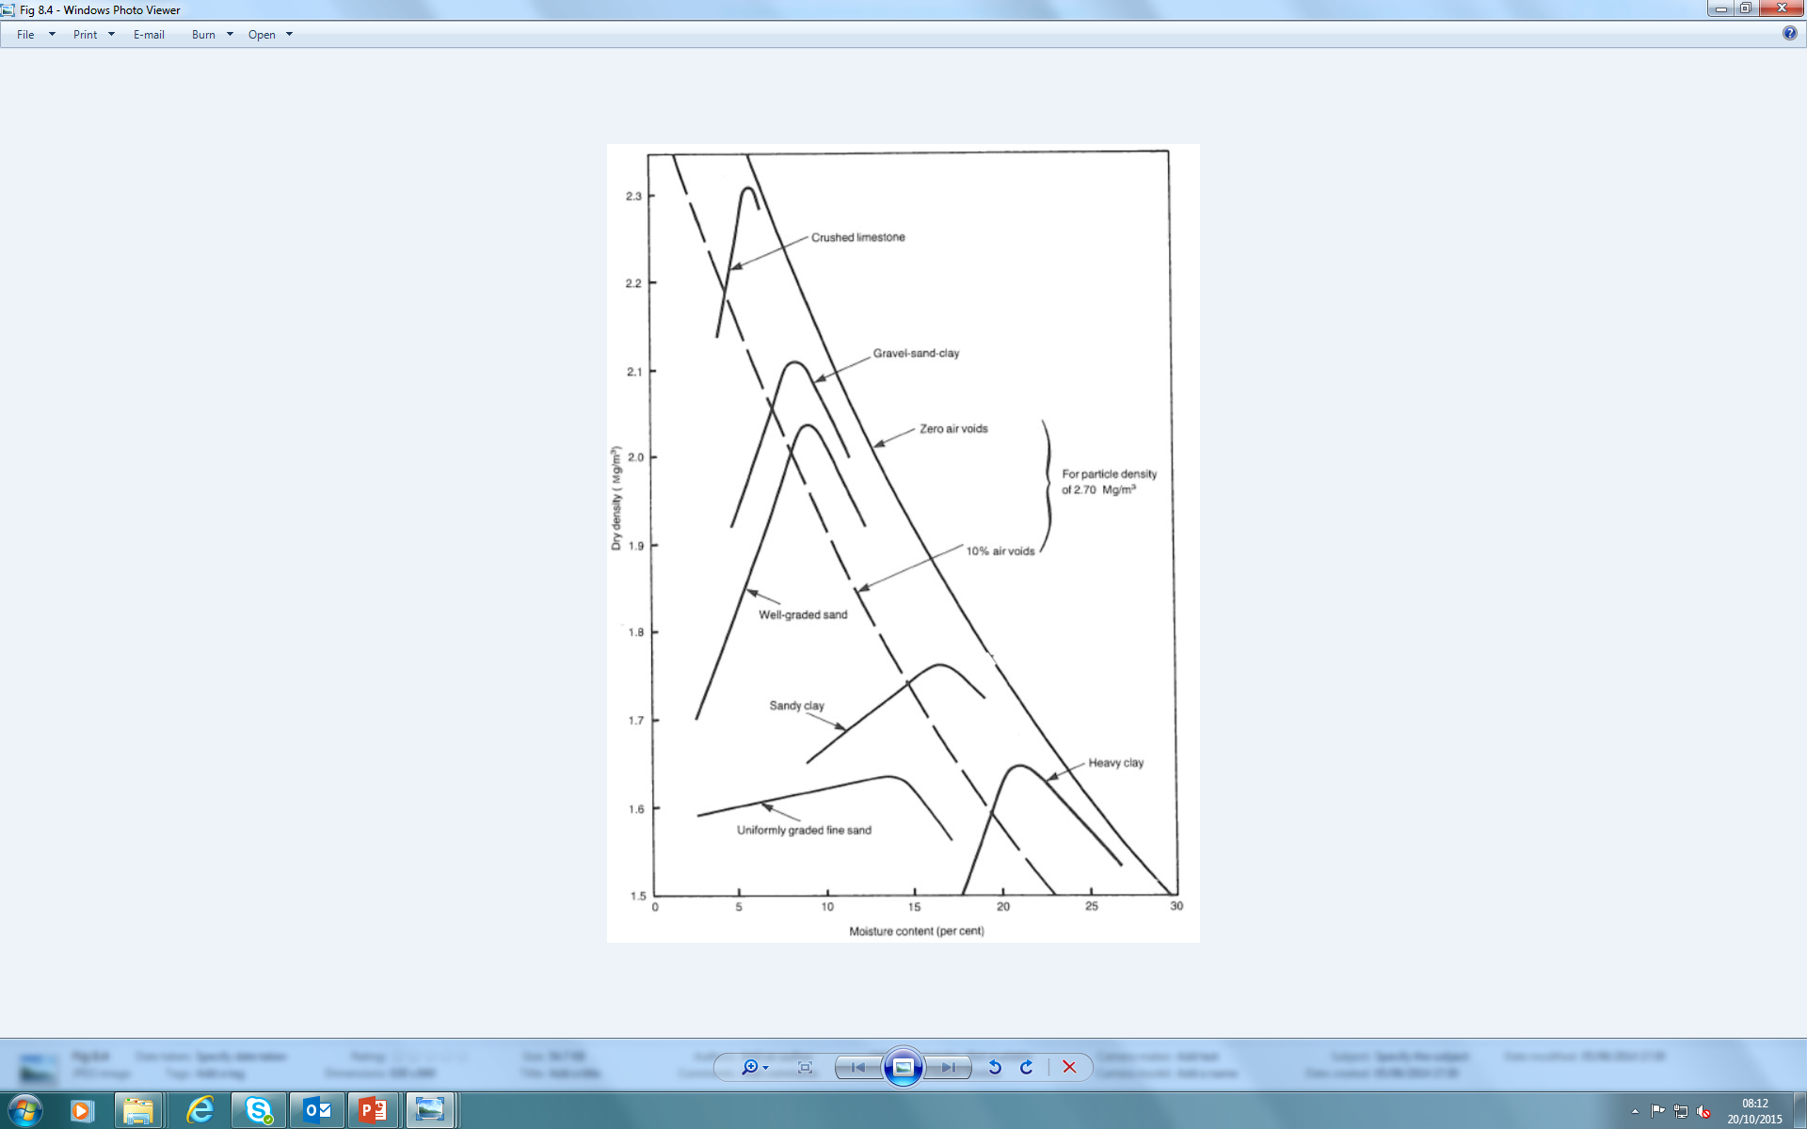
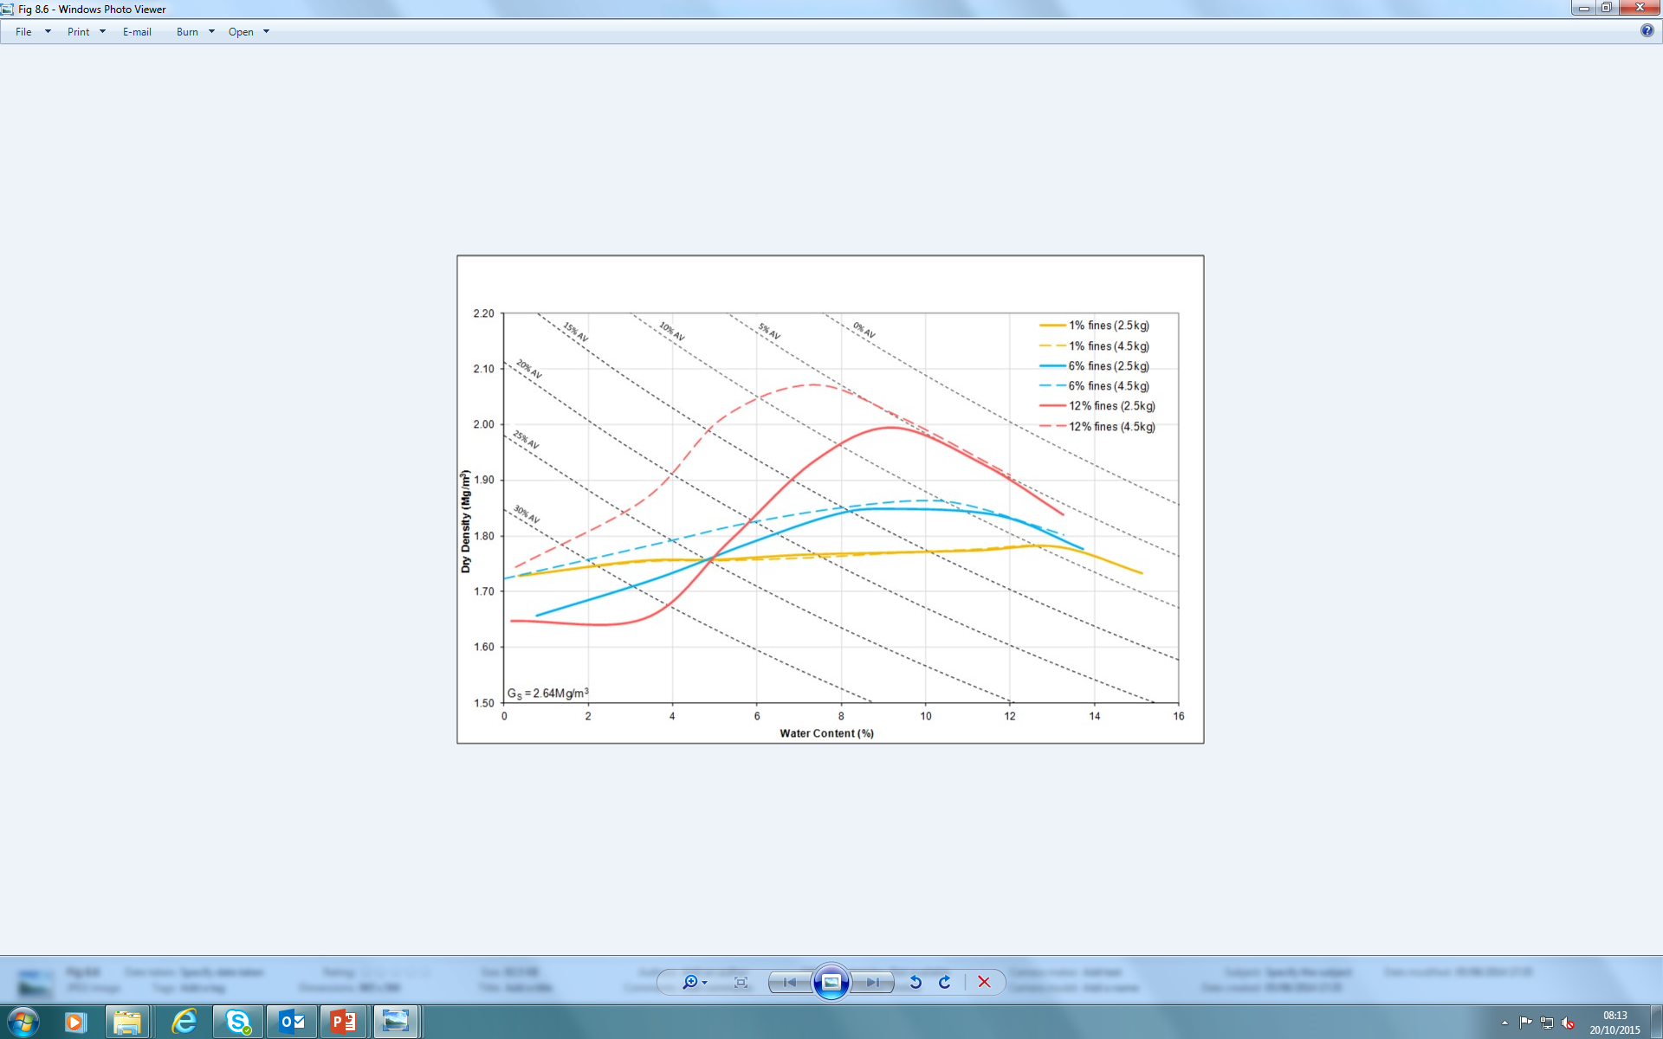
Fill behaviours
Fill can be broadly divided into groups based on grading:
Rock fills
“granular” fills
  Well graded
  Uniformly graded
Intermediate fills (e.g. glacial till)
“cohesive” fills
Silty sand
A fill materials behaviour is influenced by various intrinsic properties, e.g.
particle strength & durability (especially soft rocks, e.g. chalk)
plasticity (cohesive fills)
chemical properties (especially industrial materials)
fines content (especially granular / intermediate fills)
Uniform sand
Notes:
dramatic change in response to compaction of a fine to medium grained SAND as silt content increases

Slide 16
Design considerations
BRE (Charles, 1993): fill requirements are determined to achieve the desired behaviour, the designer must assess:
Factors affecting SLS and ULS of the finished earthwork
Compaction required for loading conditions
Initial water content range for the compaction level and confining pressures
BS 6031 (2009) brought this approach into UK earthworks code of practice. Describes the selection of acceptable limits of water content / strength / density / air voids, to:
Ensure fill can be trafficked and compacted during construction
Ensure earthwork stability during & after construction
Avoid excessive settlement or heave
Earthworks: a guide (2015) gives details of various fills and situations to achieve these goals.
Notes:
Earthworks: a guide (2015) gives details of various fills and situations to achieve these goals.
………….How to fit in fig 8.3 coloured in 5 times……….

Slide 17
Desirable properties of compacted Fill
Should reflect the end use of the particular earth structure, e.g.
Low air voids
High density
Adequate strength
Low permeability (e.g. flood bunds)
High permeability (e.g. drainage layers)
High stiffness (to minimise settlement)
Utilisation of available material (e.g. landscape bunds)
The required level of compactive effort should reflect the end use, e.g.:
Structural fill beneath buildings
Highway embankments (SHW method compaction)
Landscape fill

Slide 18
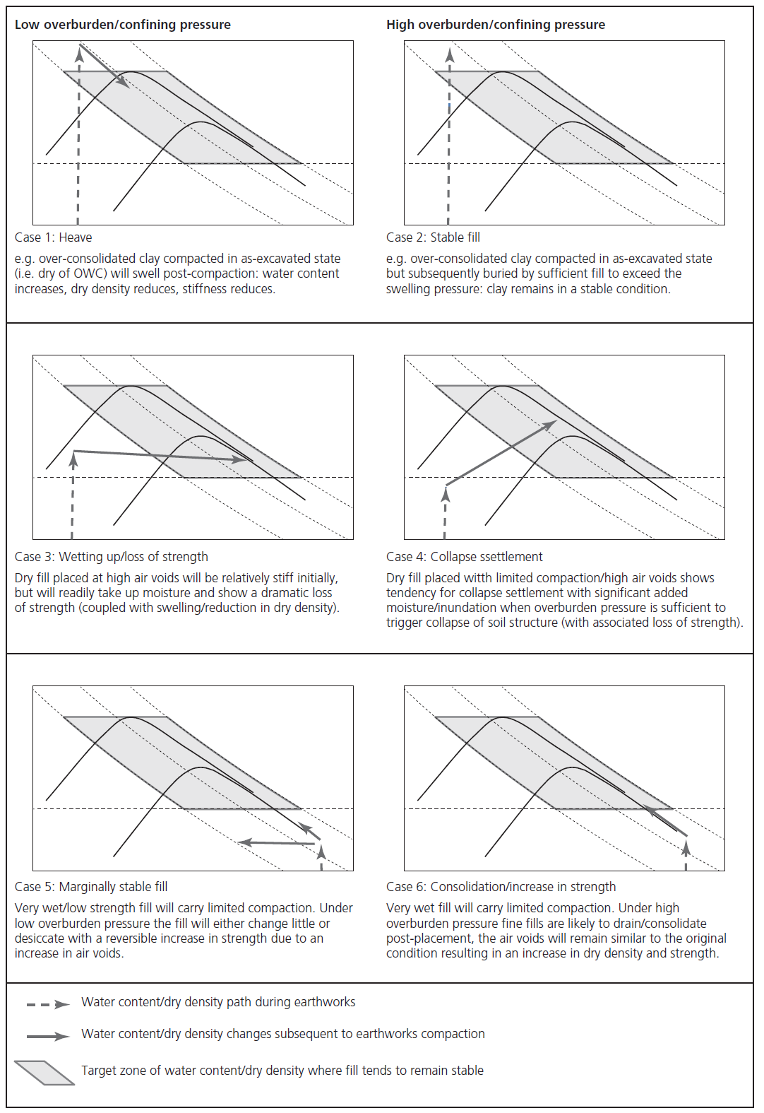
Fill behaviours to avoid
Designer should assess potential problems during construction, and help the Contractor to avoid these for the sites ground conditions and fill material type, e.g.:
Over-compaction (“mattressing” due to locked in pore water pressure)
Under compaction
Softening of subgrade due to poor drainage / trafficking
Saturation of fill material
Design sets Specification requirements to avoid unacceptable post construction changes, e.g.:
Heave - swelling of dry fine fills
Loss of strength due to wetting up
Collapse settlement
Don’t rely on achieving 95% of maximum dry density
Do consider air voids, future overburden pressure & end use

Slide 19
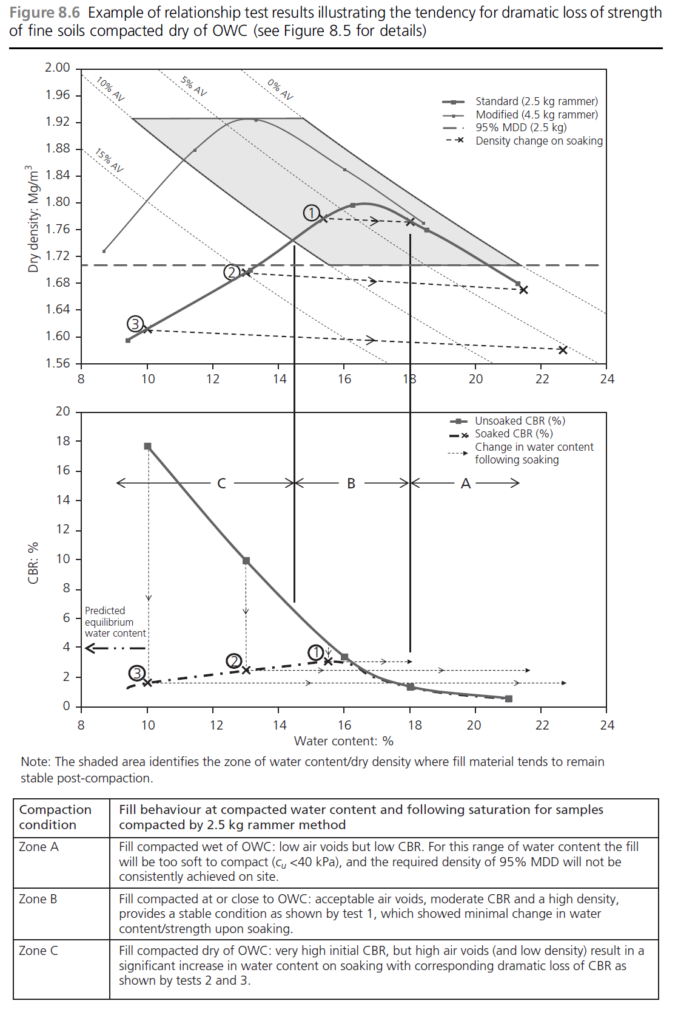
Relationship testing
Example of Relationship Testing for a fine grained fill (with CBR testing on compacted samples):
Zone A – fill compacted wet of optimum has low air voids, but low strength will hinder compaction (Cu<40kPa)
Zone B – fill compacted close to optimum can achieve low air voids, adequate short term strength, and stable in the long term
Zone C – fill compacted dry of optimum has high air voids and high initial strength is lost on saturation
Shaded area = zone of water content / dry density where fill material is likely to remain stable post-compaction.
Note
you don’t need all this data to plot relationships between fill properties
SHW approach only sets wc range only (e.g. Zone B)

Slide 20
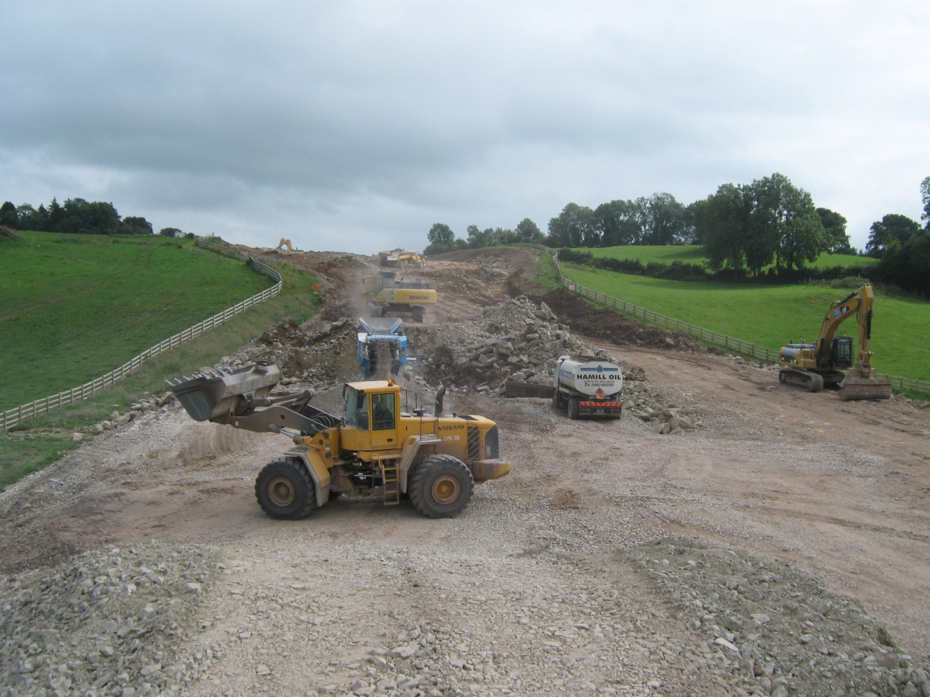
Tools available to aid design
Experience of similar fills
Relationship testing
Compaction trials
Instrumentation
Site supervision (construction monitoring)
Earthworks design is an iterative process

Slide 21
Earthworks Specifications
  Method Specification
    Designer sets fill material acceptability limits in Table 6/1
    SHW Table 6/4 defines the compaction method (layer thickness + number of passes for type of compaction plant)
    Table 6/1 sets required compaction method for the class of fill in order to achieve:
        <10% air voids for well graded and cohesive general fills
        <5% air voids for capping
        >95% MDD (2.5kg test) for uniform granular fills
  2) End Product Specification
    Designer states the soil properties to be achieved (e.g. SHW structural fill >95% MDD)
    Contractor must determine compaction method to achieve the target
  3) Performance Specification (performance of finished earth structure)
    Normally defined in terms of required SLS, e.g.
        Ride quality on road or rail embankment
        Allowable bearing pressure + permissible settlement for foundation
    Difficult to implement as performance only confirmed during operation
Designer sets the quality control testing required

Slide 22
Recognition of “earthworks fill design” within standards
SHW required earthworks fill design approach
EC7 was not written for earthworks
BS 6031 (2009) - code of practice requires earthworks fill design (application standard for EC7)
European Earthworks standards are being developed prEN 16907 parts 1 to 7
  similar approach to BS 6031
  aim is to draw together European earthworks practices

Slide 23
Earthworks – Analysis & Factors of Safety

Slide 24
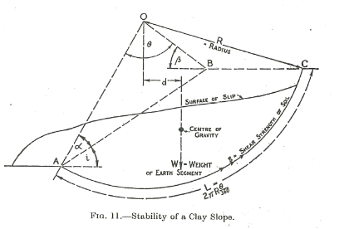
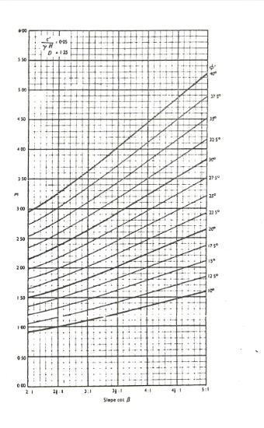
Earthworks – Analysis & Factors of Safety
  Bishop (1955) developed a theoretical method of analysing circular potential failure surfaces. Developed by Morgenstern and Price (1965) and Janbu (1972) for analysis of non-circular failures.
  Early methods were constrained by calculation capability (generally log tables & slide rule) so led to development of a minimum of variables
  Construction of a critical failure circle geometrically (Fellenius) was developed to limit the number of analyses
  Stability charts developed by Taylor (1948) and Bishop and Morgenstern (1960)
  Analysis charts developed to provide a quick answer to slope stability analysis with input of c', Φ’ and r_{u}

Slide 25
Earthworks – Analysis & Factors of Safety
  Back analysis of slope failures by Skempton & Chandler in 1950’s & 1960’s
  Predominantly determining worst credible parameters form failures in London Clay, Lower Lias and Keuper Marl in terms of c' and Φ’ along known failure surfaces
  Development of computer analysis from 1980’s
  Initially as failure planes through the toe of the slope or along a predefined plane mirroring previous analytical work
  Development of computer programmes has led to analysis of multi failure surfaces with little awareness of the influence of soil properties/groundwater levels and failure surface geometries when final results are achieved
  Perry (1989) TRL RR199 developed an asset performance guide. Limited in soil types surveyed.
  The findings are used to determine the stability of new and existing slopes but the study recorded shallow failures only that required remediation.

Slide 26
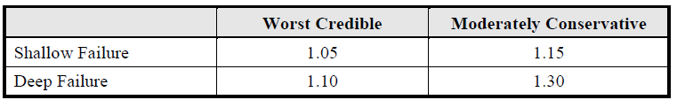
Earthworks – Analysis & Factors of Safety
Traditionally:
Analysis using best estimate values with lump factor e.g. 1.3 from BS 6031:2009, moderately conservative from BS8002 or worst credible.
Could be adapted based on the input values e.g. Perry (2003)
    Ability to carry out parametric analysis and vary target Factor of Safety with respect to soil parameters, loads and groundwater levels

Slide 27
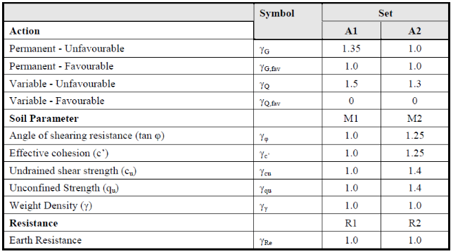
Earthworks – Analysis & Factors of Safety
Eurocode 7:
    Mandatory on Government projects from April 2010
    Developed from structural engineering design for elastic perfectly plastic materials
    Partial factors on input values - Design Approach 1(NA to EC7)
Comb 1: A1 + M1 + R1
Comb 2: A2 + M2 + R1
    Less opportunity to experiment with input parameters e.g. groundwater level and applied load
    Characteristic Strength and values of load and groundwater
Loads developed from EC0/BS5400

Slide 28
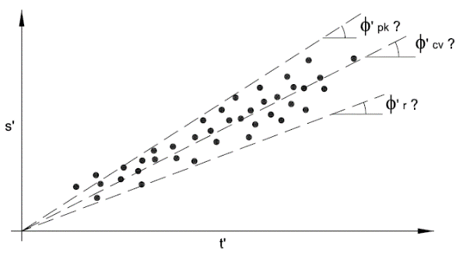
Earthworks – Analysis & Factors of Safety
    Clause 2.4.5.2 (P) of EN1997-1 defines the characteristic value as ‘a cautious estimate of the value affecting the occurrence of the limit state’
    Don’t confuse characteristic value with best estimate or moderately conservative design values but it could be the same
    The characteristic value is generally a choice based on engineering judgement and although is likely to equate to a value close to the best estimate value may tend to worst credible if the consequences of failure are deemed to be exceptionally serious. It should not be considered as the result of a statistical analysis as described in EN 1991.
    The choice of a value tending to worst credible must be viewed in the light of the likely failure mechanism and the fact that design values will have been assigned a subconscious partial safety factor prior to those applied through Eurocode 7.
Choice of Characteristic Value
    Is Φ’cv equivalent to characteristic strength?
    Does choice of Φ’r represent partial safety factor?

Slide 29
Earthworks – Modes of Failure

Slide 30
Earthworks – Modes of Failure
Failure during construction:
Cuttings
Presence of geological structures, bedding/laminations/fissures
Pre-existing shear surfaces (A21 Sevenoaks, M25 Godstone)
Zones of contrasting permeability (M3 Camberley)
Embankments
Failure of foundation on soft ground by lack of strength/ increase in pore pressure during loading.
Slope height, geometry and angle

Slide 31
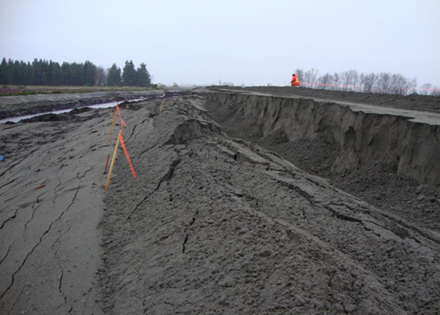
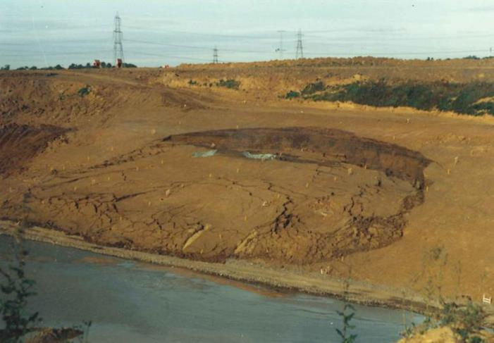
Earthworks – Modes of Failure
Failure during construction

Slide 32
Earthworks – Modes of Failure
Failure during Operation
Equalisation of pore pressures after construction
Shrink/swell induced due to seasonal moisture changes and vegetation.
Deterioration of drainage
Presence of water in the embankment over time (mostly railways as water can enter through the ballast)
Work by Skempton & Chandler in 1950's & 1960's showed time dependent failure of earthworks cutting slopes particularly in over consolidated clays
Potts et al developed the theory of Progressive Failure in slopes in over-consolidated clay
Studies by Perry (1989), Crabb & Atkinson (1991) and Perry, Pedley & Reid (2003) showed failure surfaces were usually to a maximum depth of 2.5 metres into the slope.

Slide 33
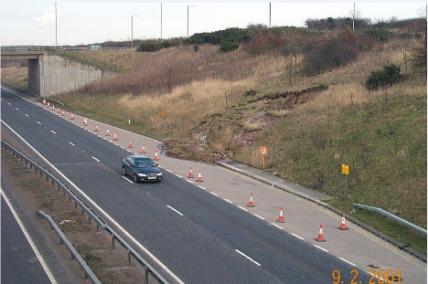
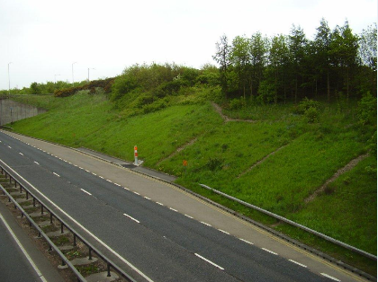
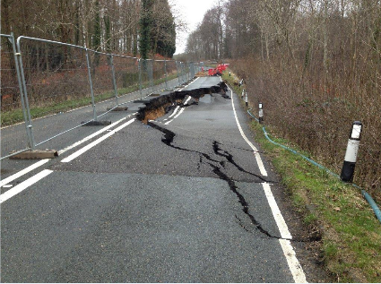
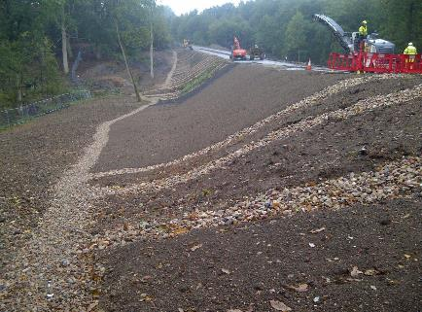
Earthworks – Modes of Failure
Failure during operation

Slide 34
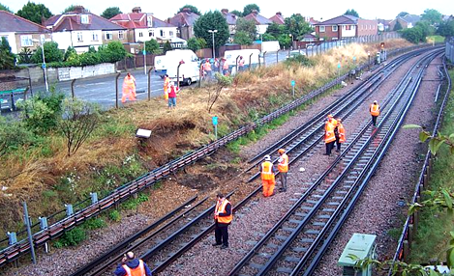
Earthworks – Modes of Failure
Failure during operation

Slide 35
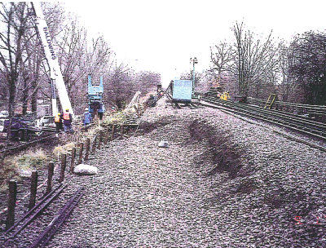
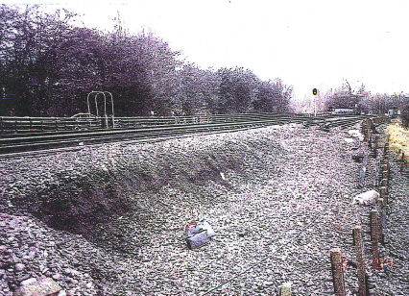
Earthworks – Modes of Failure
Failure during operation

Slide 36
Earthworks – Modes of Failure
Failure during operation:
Consider also SLS failures which could cause disruption of service or disruption to adjacent third parties.
Settlement of embankment over time
Softening of base of cutting
Rail more critical than road (5mm maximum differential settlement across rails)
Lateral movement of cutting slope
Causes settlement of adjacent buildings/services

Slide 37
Earthworks – Management of Existing Assets

Slide 38
Earthworks – Management of Existing Assets
There is a considerable numbers of linear miles of exiting road and rail assets in the UK that need to be considered from the point of view of resilience.
Rail assets were generally constructed some 100 -175 years ago with no mechanised plant and before Soil Mechanics was invented.
Most of the major trunk road and motorway network is 30 – 40 years old.
Failures during operation detailed previously
Ground Investigation of existing assets is difficult as exploratory holes cannot be positioned due to live traffic or landowner issues.
Work by Perry (TRL RR199) provides a useful guide to ‘in service’ stability of highway assets.

Slide 39
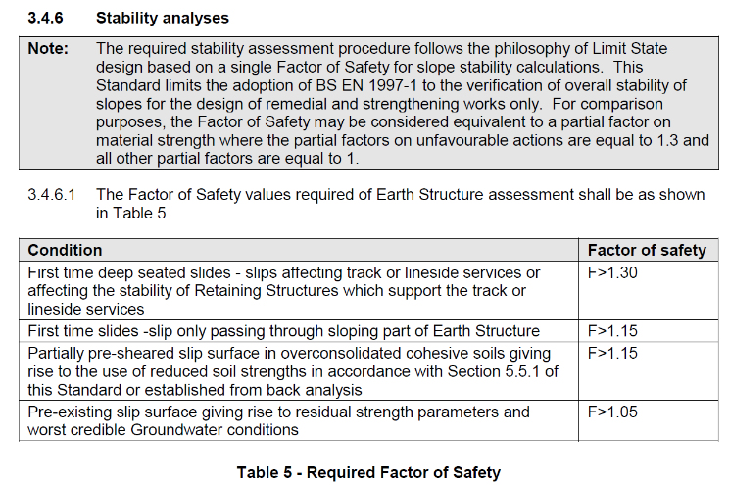
Earthworks – Management of Existing Assets
Is it right to assess existing Infrastructure assets to current design Standards or should they be assessed to the design Standards applicable when they were constructed??
HE IAN 161/13 does not require betterment of existing earthwork assets and not worse than for widened earthworks.
LUL Engineering Standard 1-054 Civil Engineering - Earth structures has an interesting interpretation of Eurocode 7.

Slide 40
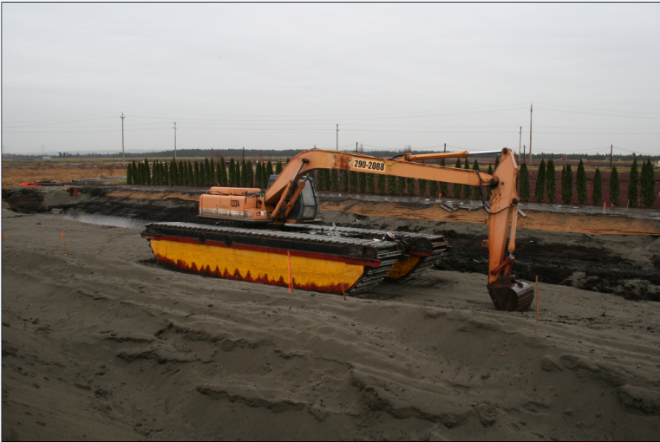
Questions ?

